Slide 1


Slide 2
There are two main types of Chi-Square tests namely
Independence - The Chi-Square Test of Independence is a derivable ( also known as inferential ) statistical test which examines whether the two sets of variables are likely to be related with each other or not. This test is used when we have counts of values for two nominal or categorical variables and is considered as non-parametric test. A relatively large sample size and independence of obseravations are the required criteria for conducting this test.
Goodness-of-Fit -In statistical hypothesis testing, the Chi-Square Goodness-of-Fit test determines whether a variable is likely to come from a given distribution or not. We must have a set of data values and the idea of the distribution of this data. We can use this test when we have value counts for categorical variables. This test demonstrates a way of deciding if the data values have a “ good enough” fit for our idea or if it is a representative sample data of the entire population.

Slide 3
Example: Independence:
In a movie theatre, suppose we made a list of movie genres. Let us consider this as the first variable. The second variable is whether or not the people who came to watch those genres of movies have bought snacks at the theatre. Here the null hypothesis is that th genre of the film and whether people bought snacks or not are unrelatable. If this is true, the movie genres don’t impact snack sales.

Slide 4
Example: Goodness of fit
Suppose we have bags of balls with five different colours in each bag. The given condition is that the bag should contain an equal number of balls of each colour. The idea we would like to test here is that the proportions of the five colours of balls in each bag must be exact.

Slide 5
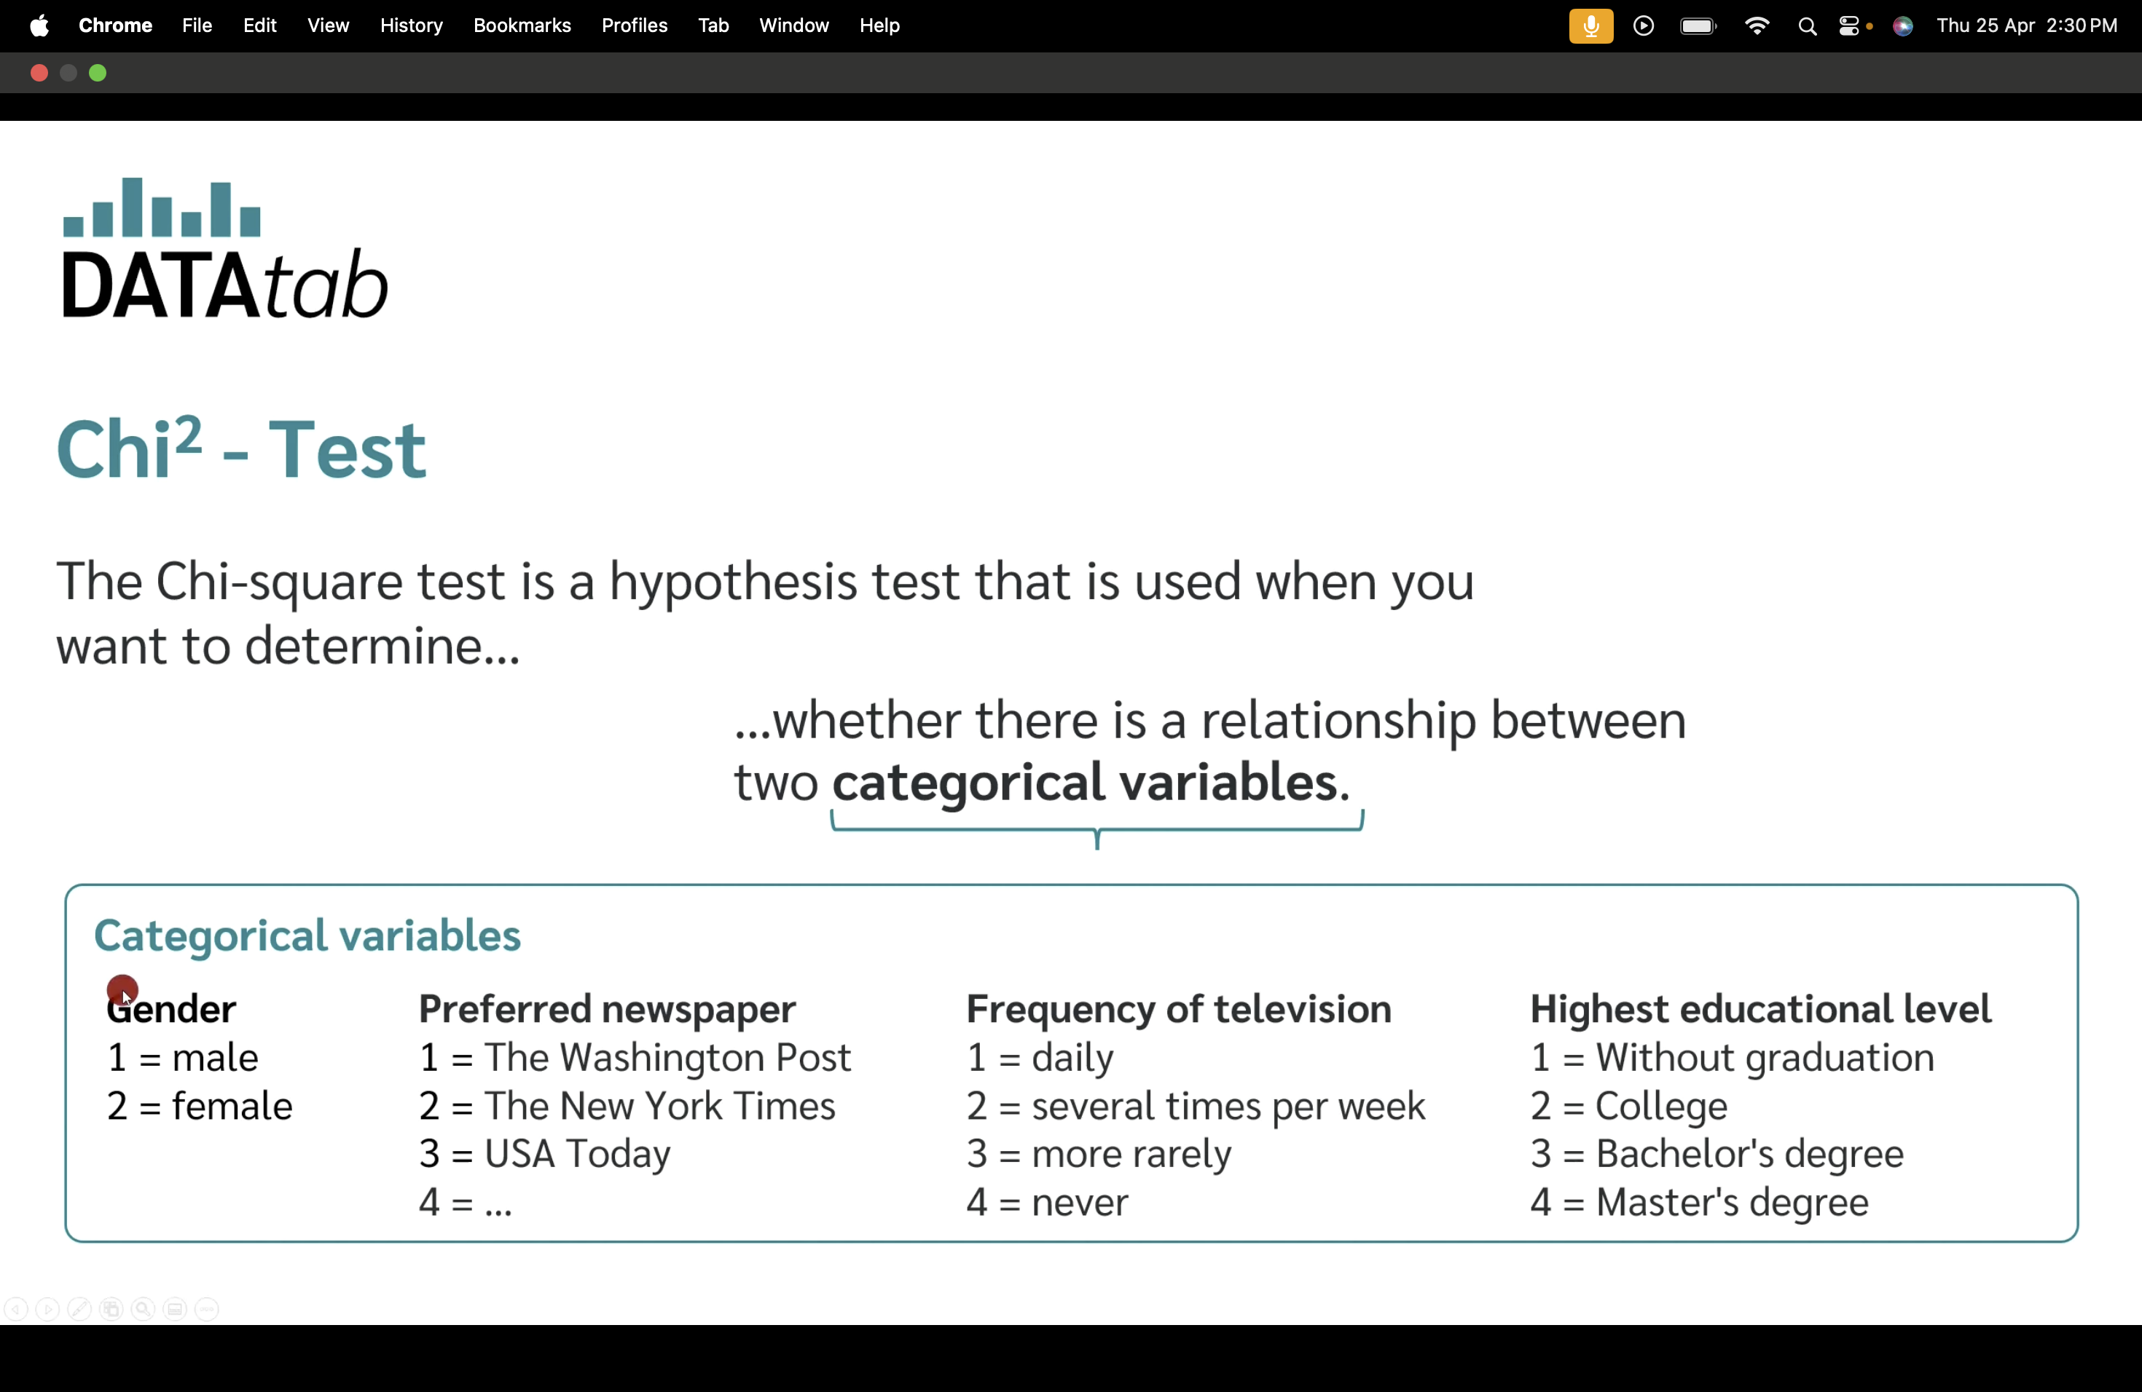

Slide 6
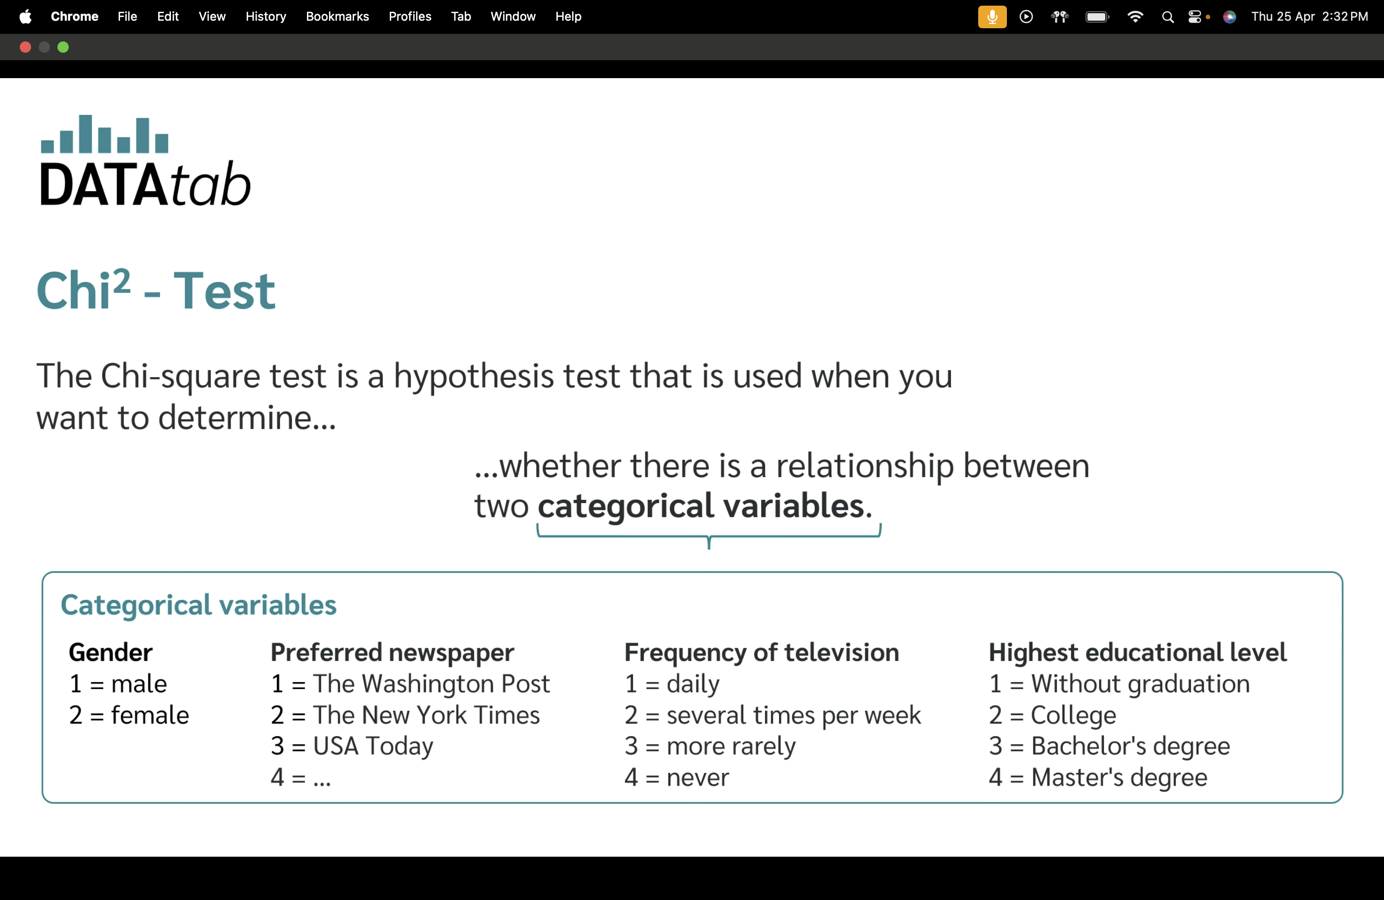

Slide 7
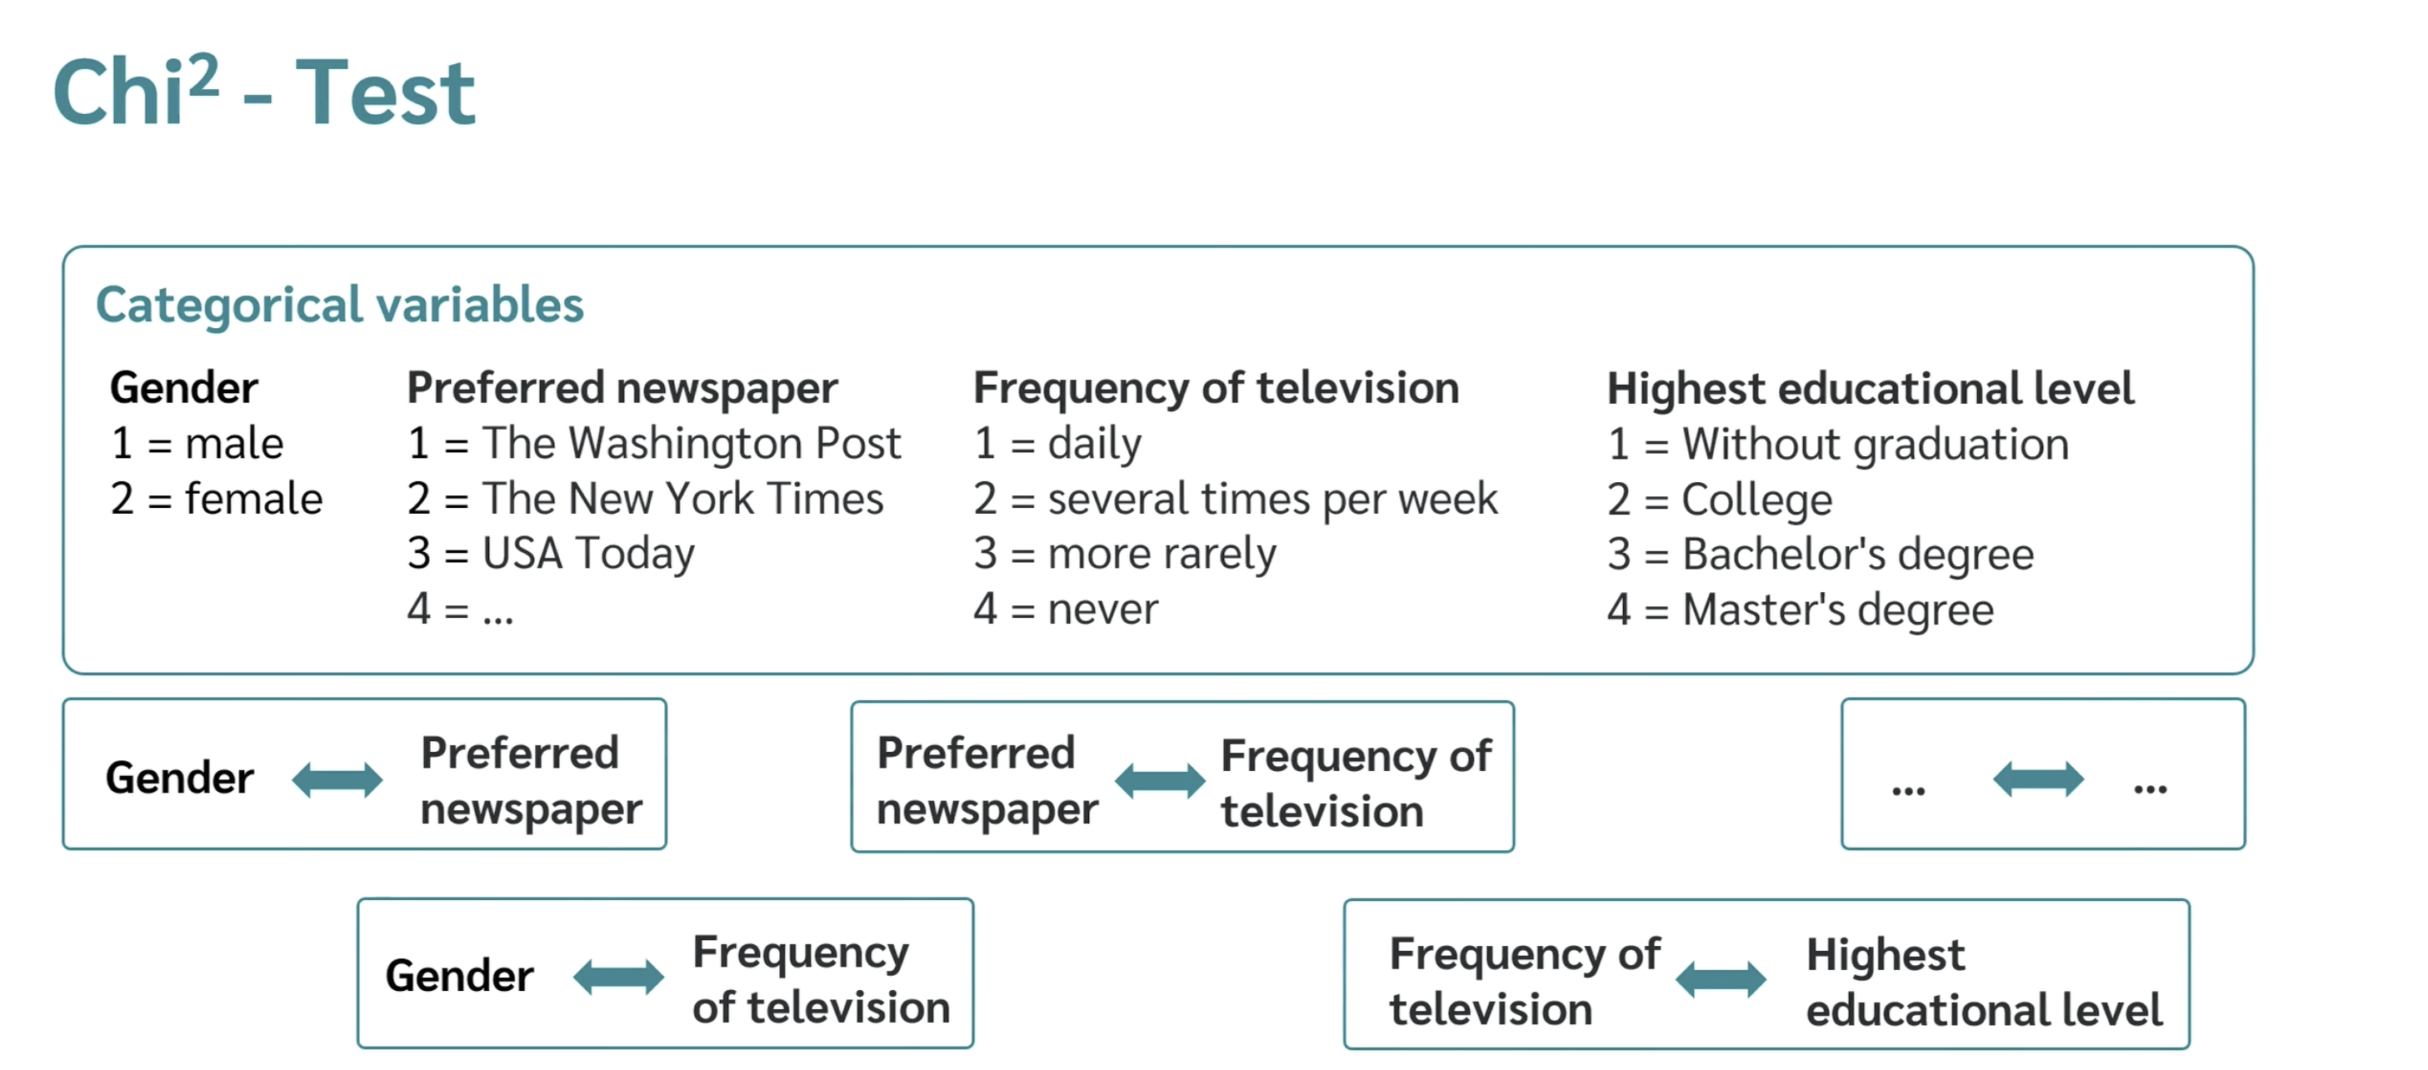

Slide 8
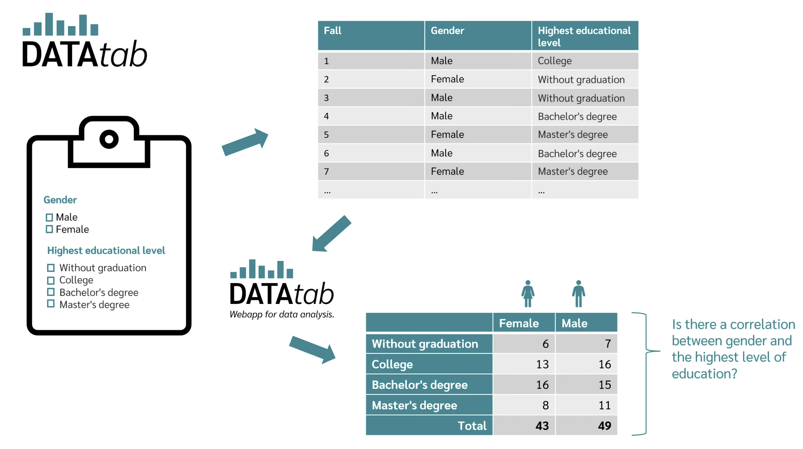

Slide 9
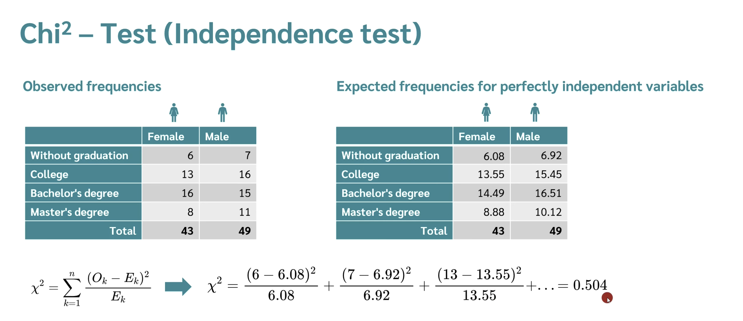

Slide 10


Slide 11
